Slide 1
Reclaim your heart
By Yasmin Mogahed

Slide 2


Table of contents
Introduction
Insight
Conclusion

Slide 3
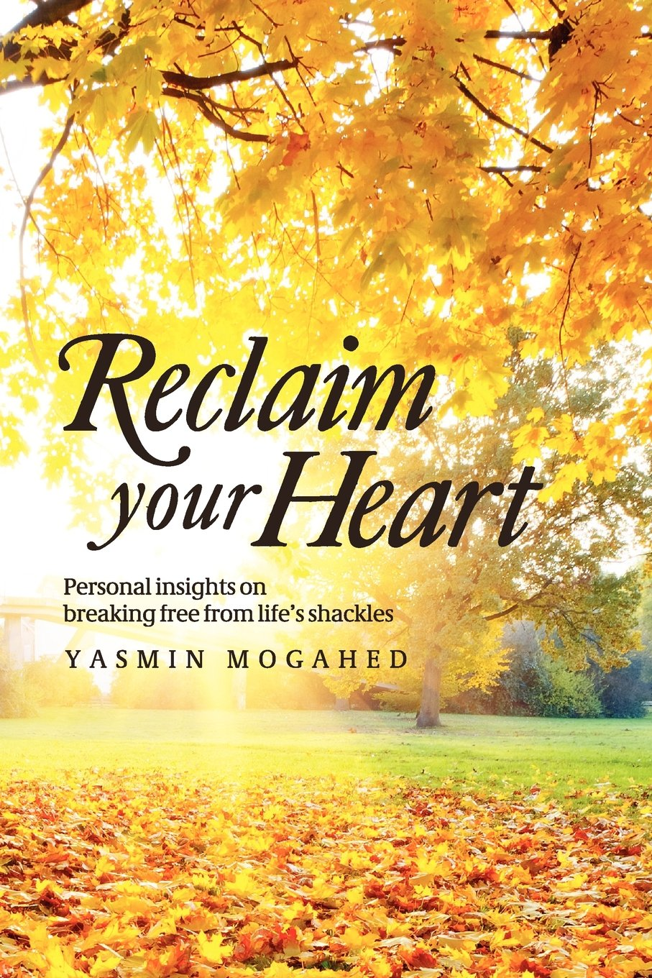
Introduction
It is the book about how to keep your heart from sinking in the depths of that ocean, and what to do when it does. It is the book about redemption, about hope, about renewal.
Every heart can heal, and each moment is created to bring us closer to the transformative return.
Reclaim Your Heart is about finding that moment when everything stops and suddenly looks different. It is about finding your awakening. And then returning to the better, truer, and freer version of yourself.

Slide 4


Insight

Slide 5
The book consists of 7 enlightening chapters which are:
Attachments
Love
Hardships
Relationship with the creator
Women’s status
Ummah
Poetry

Slide 6
Attachments
We attach ourselves with worldly beings and things. And this leaves us devastated because we try to attain perfection in this imperfect temporary world
This life isn’t perfect, for if it was, what would the next be called.
5 pillars of Islam are a source of detachment from this world, if we attach ourselves with the Creator, we will become unbreakable.

Slide 7
Reclaim your heart and place it with its rightful owner: Allah.
This world cannot break you – unless you give it permission. And it cannot own you unless you -- give it your heart. And so, if you hand those keys to dunya for a while -- take them back. This is not the End. You don’t have to die here.

Slide 8
Love
Falling in love such that we depend or enslave to a worldly being. In doing so we create the worst and the most painful of prisons; because it takes you away from the ultimate, unending and perfect: Allah and our relationship to Him.
True love provides you peace and calm and it should never contradict with one’s love for Allah.
The only true fulfillment of love will occur when your heart is content with the love of God.
This is the liberation of the self from the servitude to any created thing. That is love.

Slide 9
Hardships
The hardships are an important part of our life that are there for the sole purpose of testing a Muslim whether he comes to Allah or not.
Prophet Musa (AS) through his complete faith crossed the Red Sea, Prophet Ibrahim(AS) jumped into the fire.
This transient place for humans will always tear us apart and break us to our soul.
We must remember that everything in life is a test and has purpose
Good doesn’t happen to bad and bad doesn’t happen to good. It is how we perceive things and how we react to it.

Slide 10
Relationship with the creator
Salah is food to the soul and a source to have conversation with the Benefactor. Offering prayer to the Muslim is the same as breathing oxygen. Salah brings you closer to your Creator.
We pray for a happy life in this Dunya and indeed it is He who knows what is good and bad for us.
“Know that the path to Allah is not a flat one. Your Iman (faith) will go up and down. Your ability to worship will go up and down. But know that for every dip, there is a rise. Just stay patient, stay consistent, don’t lose hope and seek help in Allah. The path is hard. The path will have bumps and drops. But like all things in life, this path will come to an end. And that end will make it all worth it!”

Slide 11
Women’s status
God dignifies both man and woman in their distinctiveness—not their sameness.
Women should have a strong relationship with Allah instead of fitting in to the male dominant society where becoming manly as a woman is better in their opinion.
A society where harshness and masculinity is considered spirit and true manliness and where being a macho is better than being gentle, we as Muslims should pursue being the same character as our Holy Prophet.
Being the same gentle, loving human being as him.
“He who is deprived of gentleness is deprives of good.” [Muslim]

Slide 12
Ummah
Muslims are now divided into different groups in the modern society. They have forgotten that they share a common creed.
The more we follow the rulings of Islam, the more moderate we become. And as Islam is by nature timeless, we will always remain modern if we follow Islam truly.
By striving for Allah with sincere faith, we can change the bad condition of the Muslim Ummah in the present time.
We need to wake up and return to Allah if we are to fix the conditions of the Muslims in this world in places like Syria or Palestine or Kashmir

Slide 13
Conclusion
Many of us live our lives entrapped by the same repeated patterns of heartbreak and disappointment. Often, we have no idea why this happens. Reclaim Your Heart is about freeing the heart from this slavery. It is about the journey in and out of life’s most deceptive traps.
This book was written to awaken the heart and provide a new perspective on love, loss, happiness, and pain. A manual of sorts, Reclaim Your Heart will teach readers how to live in this life without allowing life to own you. It is a manual of how to protect your most prized possession– the heart.

Slide 14
Conclusion
The book touches the heart of the reader and opens their eyes to a whole different perspective. For humans it is hard to achieve true peace and happiness in this life. The book teaches the reader where to seek and how to fill the holes in our life throughout different aspects of life.
This book is a must read for it provides the reader with a powerful message. The book imbues a sense of calm and peace in the reader.

Slide 15

Thank you
By Muhammad Abdullah Khan, Muhammad Junaid Ali, Shahzaib Ahmed Hassan, Muhammad Salman Azam

